Slide 1


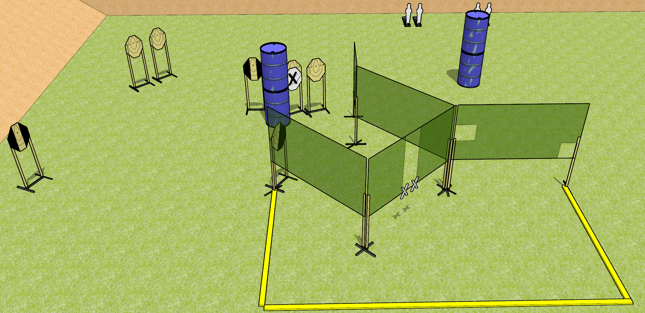
 | Dothan Gun Club – USPSA Match Punch Buggy Course Designer : Drew Coleman
START POSITION : Standing with both hands touching marks. PCC muzzle touching right hand mark.
GUN READY CONDITION : Pistol loaded and holstered. PCC loaded, shouldered, safety on. |  | SCORING: Comstock, 20 rounds TARGETS: 8 paper, 4 Steel SCORED HITS: Best 2 on paper, steel until down START-STOP: Audible, last shot RULES:
STAGE PROCEDURE: Engage targets as they become available from within the fault lines.

